Slide 1

Food price from 2005 to 2021
Analysis of food price variations in Haiti
Ayiti Analytics
Monthly report
Prepared by
Fritz Gerald Junior Valcin

Slide 2

Matters on the project
A brief look on the project
01
Objective
02
Hypothesis
03
Data source
04
Data cleaning
05
Data analysis
06
model
07
Reflexion

Slide 3
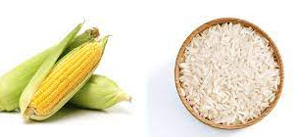
Search for the trend of the price evolution
Understand the factors that influence the price of food
Look for ways to lower prices
Predicting the price of rice in Port-au-Prince with ADL model
Objective

Slide 4
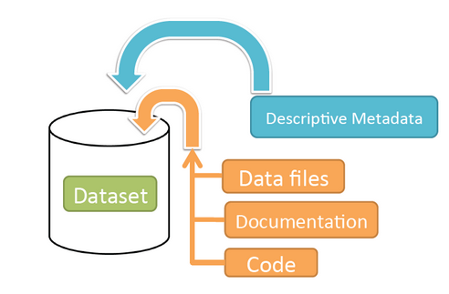
Data
Retrieval of data on:
The price of food in different municipalities in the country from 2005 to 2021.(site:https://data.humdata.org/dataset/wfp-food-prices-for-haiti, file:wfp_food_prices_hti (1))
The price of fuel during this period (file : https://docs.google.com/spreadsheets/d/1nbVAoaKjWFuFaci0ioH_rIirsOLD_89JowmkX0wB9HM/edit#gid=1457867413)
The exchange rate of the US dollar during this period (file:HTG=X)

Slide 5
Total imported product:
-Beans -Maize Meal - Oil -pasta -Rice -Sorghum -Sugar -Wheat flour
Plan
-Product X product analysis
-Analysis local product price X imported product price
-Analysis category X category
-Price evolution by category
-Analysis of large prices X USD prices
-Price variation by department over the last 15 years
Total local product:
-Maize Meal -Rice
We will use only the price in gourdes instead of the two prices (gourdes and US dollars) to avoid multicolinearity.

Slide 6
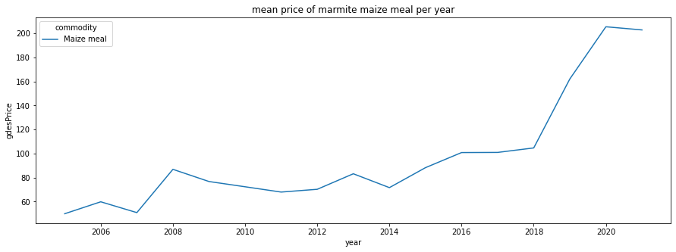

Local food analysis
The average price of a pot of corn began to increase since the end of 2007 and reached its peak in 2008 with the phenomenon "Grangou Klorox", and since then, the price have attenuated to rise again since January 2014 after the people demanded the departure of President Michel Joseph Martelly.

Slide 7
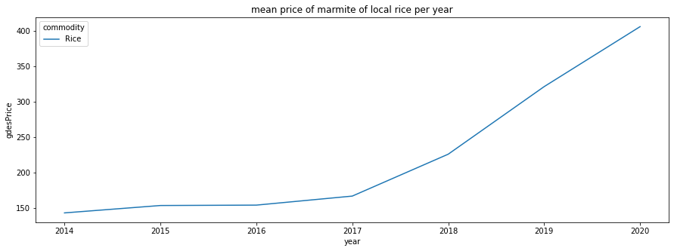

Local food analysis
Nous pouvons remarquer que l'ascension de la marmite du riz local commence des 2017 apres que L'ouragan Matthew dévaste le département de Grand’Anse, et notamment la ville de Jérémie, les départements du Sud, des Nippes et une bonne partie de l'Ouest dont Petit-Goâve

Slide 8
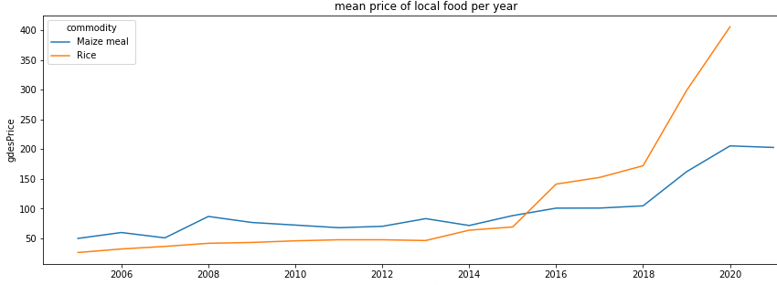

From 2005 to 2020 we notice that both prices increase, but under the Martelly Paul government the price of rice consumption exceeds the price of corn. But still remains the national dish

Slide 9
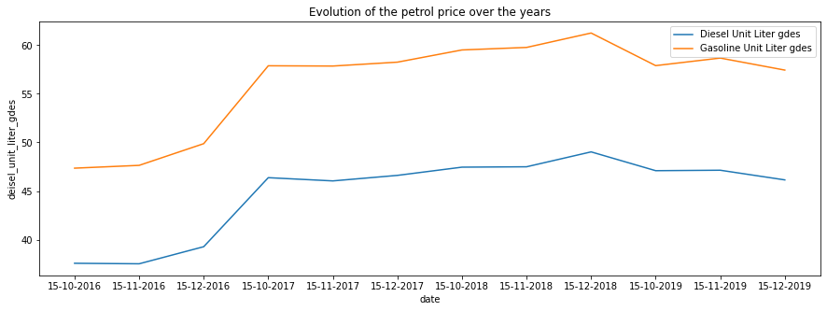

The trend of petrol prices is increasing despite their fluctuations of the descent

Slide 10
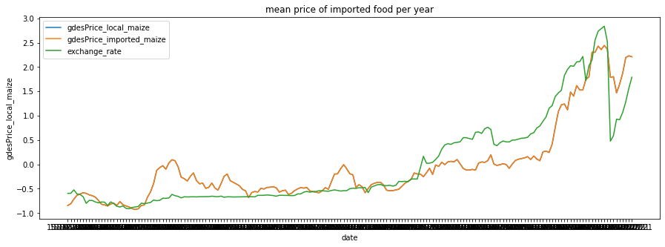
Imported and local food prices evolve in the same way, the gourdes price of local food and imported food increase in the same way, one appears on the other.

Slide 11
The problem with the Haitian economy in relation to rice is that first of all the national dish is rice. Almost the entire population eats rice, or consumes it on a regular basis.
After analyzing the data, we notice that the price of rice keeps increasing, and when analyzing other variables such as the price of petrol, or the exchange rate, they increase along with the price of food. This represents a serious problem because wages take longer to increase than inflation in the economy.

Slide 12
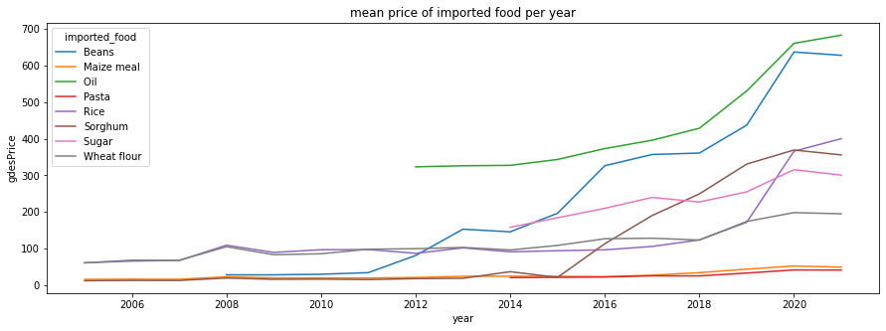
Imported food analysis
The prices of all imported products increase over time

Slide 13
Recommendation
- A court terme: subventionner le riz etranger, stimuler la production de riz national
- A moyen et long terme: produire le riz national, dresser des barrieres tarifaires a la douane contre le riz etranger

Slide 14










Resource
Page

